Slide 1

Using Standard Java Packages
Firoz Ahmed
Associate Professor
Department of ICE, RU
December 21st, 2014

Slide 2
A package is a namespace that organizes a set of related classes and interfaces
A Java package is a mechanism for organizing Java Classes into namespaces
Java packages can be stored in compressed files called JAR files

Slide 3
Outlines of Presentation
Creating Graphical User Interfaces with AWT
Managing Graphics Objects with GUI Layout Managers
Event Handling of Various Components

Slide 4
Creating Graphical User Interfaces with AWT
AWT Packages
Containers and Components
AWT Container Classes
AWT Component Classes
Example

Slide 5
AWT Packages
Abstract Window Toolkit (AWT) is a set of Application Program Interfaces (API s) used by Java programmers to create Graphical User Interface(GUI) objects, such as buttons, scroll bars, and windows
AWT provides a platform-independent and device-independent interface to develop graphic programs that runs on all platforms
Windows, Mac, Unix, etc.
AWT is huge! It consists of 12 packages
Fortunately, only 2 packages are commonly-used
java.awt
java.awt.event
5
Notes:
In order to use a class from Java API, one needs to include an import statement at the start of the program. For example, in order to use the Scanner class, which allows a program to accept input from the keyboard, one must include the following import statement: import java.util.Scanner; The above import statement allows the programmer to use any method listed in the Scanner class. Another choice for including the import statement is the wildcard option shown below: import java.util.*; This version of the import statement imports all the classes in the API’s java.util package and makes them available to the programmer. If you check the API and look at the classes written in the java.util package, you will observe that it includes some of the classes that are used often, such as Arrays, ArrayList, Formatter, Random, and many others.

Slide 6
AWT Packages
The java.awt package contains the core AWT graphics classes:
GUI Component classes (such as Button, TextField, and Label)
GUI Container classes (such as Frame, Panel, Dialog and ScrollPane)
Layout managers (such as FlowLayout, BorderLayout and GridLayout)
Custom graphics classes (such as Graphics, Color and Font)
The java.awt.event package supports event handling:
Event classes (such as ActionEvent, MouseEvent, KeyEvent and WindowEvent)
Event Listener Interfaces (such as ActionListener, MouseListener KeyListener and WindowListener)
Event Listener Adapter classes (such as MouseAdapter, KeyAdapter and WindowAdapter)

Slide 7
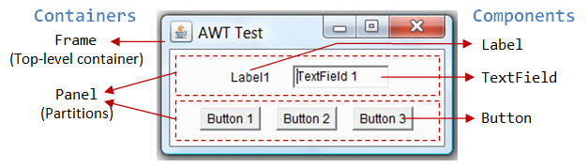
Containers and Components
There are two types of GUI elements:
Component: Components are elementary GUI entities (such as Button, Label, and TextField.)
Container: Containers (such as Frame, Panel and Applet) are used to hold components in a specific layout

Slide 8
Containers and Components
A component must be kept in a container.
Every container has a method called add(Component c)
Panel panel = new Panel(); // Panel is a Container
Button btn = new Button(); // Button is a Component
panel.add(btn); // The Panel Container adds a Button Component

Slide 9
AWT Container Classes
Top-level containers
Each GUI program has a top-level container such as Frame, Dialog and Applet
Secondary containers
They are placed inside a top-level container such as Panel and ScrollPane

Slide 10
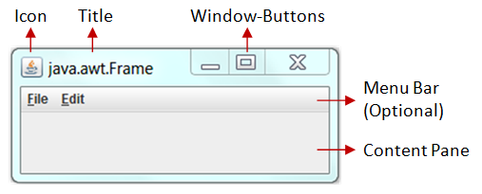
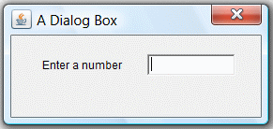
Top-level containers
A Frame provides main window
A title bar
An optional menu bar,
The content display area.
An AWT Dialog is a "pop-up window" used for interacting with the users.
A title bar
The content display area.
An AWT Applet is the top-level container for an applet, which is a Java program running inside a browser.

Slide 11
Secondary containers
A Panel is a rectangular box under a container, used to layout a set of related GUI components
ScrollPane (which provides automatic horizontal and/or vertical scrolling for a single child component)

Slide 12
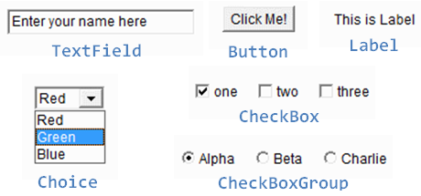
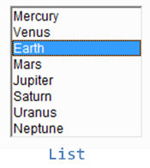
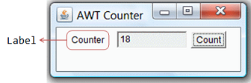
AWT Component Classes

Slide 13
Example
import java.awt.* ;
public class hello
{
public static void main(String args[ ] )
{
Frame f = new Frame ("My Frame");
Button b = new Button("OK");
TextField tf = new TextField("Programming in Java", 20);
f.setLayout(new FlowLayout());
f.add(b);
f.add(tf);
f.setSize(300, 300);
f.setVisible(true);
}
}

Slide 14
Example
import java.awt.* ;
import java.awt.event.* ;
public class hello
{
public static void main(String args[ ] )
{
Frame f = new Frame ("My Frame");
MyGuiAction ga = new MyGuiAction(f);
}
}
class MyGuiAction implements ActionListener
{
static int count = 0;
Button b;
TextField tf;
MyGuiAction(Frame f)
{
b = new Button("OK");
b.addActionListener(this);
tf = new TextField("Hello Java", 20);
f.setLayout(new FlowLayout());
f.add(b);
f.add(tf);
f.setSize(300, 300);
f.setVisible(true);
}
public void actionPerformed( ActionEvent e)
{
if(e.getSource() == b)
{
count++ ;
System.out.println("Button is Pressed");
tf.setText("Hello Java Click "+ count);
}
}
}

Slide 15
Outlines of Presentation
Creating Graphical User Interfaces with AWT
Managing Graphics Objects with GUI Layout Managers
Event Handling of Various Components

Slide 16
Layout Managers
Java’s layout managers provide a level of abstraction to automatically map your user interface on all window systems
The UI components are placed in containers
Each container has a layout manager to arrange the UI components within the container
A container has a setLayout() method to set its layout manager
// java.awt.Container
public void setLayout(LayoutManager mgr)

Slide 17
Layout Managers
There are several layout manager classes in the AWT
The Java platform supplies six commonly used layout managers
Flow Layout
Grid Layout
Border Layout
Box Layout
Card Layout
GridBag Layout
}
Basic Layout Managers
}
Advanced Layout Managers

Slide 18
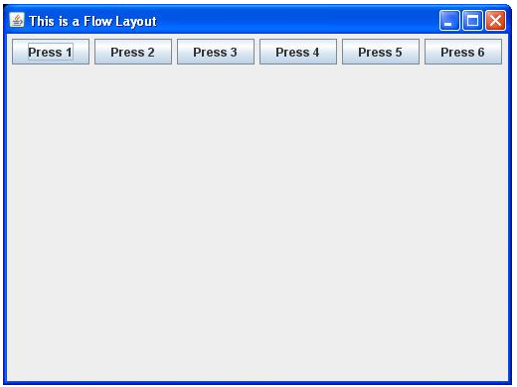
Flow Layout
It is the default layout manager for panels and applets.
It always arranges the components in horizontal rows.
The components always appear left to right in the order.
To change this default behavior , we can use setLayout( )
setLayout(new FlowLayout(FlowLayout.RIGHT))

Slide 19
Flow Layout
public FlowLayout();
public FlowLayout(int align);
public FlowLayout(int align, int hgap, int vgap);
// align: FlowLayout.LEFT (or LEADING), FlowLayout.RIGHT (or TRAILING), or FlowLayout.CENTER
// hgap, vgap: horizontal/vertical gap between the components
// By default: hgap=5, vgap=5, align=CENTER

Slide 20
Example (Flow Layout)
import java.awt.*;
import java.awt.event.*;
// An AWT GUI program inherits the
//top-level container java.awt.Frame
public class AWTFlowLayout extends Frame {
/** Constructor to setup GUI components */
public AWTFlowLayout () {
setLayout(new FlowLayout());
// Frame sets layout to FlowLayout,
//which arranges the components
// from left-to-right, and flow from
//top-to-bottom.
add(new Button("Button 1"));
add(new Button("This is Button 2"));
add(new Button("3"));
add(new Button("Another Button 4"));
add(new Button("Button 5"));
add(new Button("One More Button 6"));
setTitle("FlowLayout");
// Frame sets title
setSize(280, 150);
// Frame sets initial size
setVisible(true);
// "this" Frame shows
}
/** The entry main() method */
public static void main(String[] args)
{
new AWTFlowLayout();
// Let the constructor do the job
}
}

Slide 21
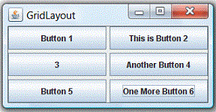
Grid Layout
In GridLayout, components are arranged in a grid (matrix) of rows and columns inside the Container
Components are added in a left-to-right, top-to-bottom manner in the order they are added
Every component in the applet in this case is exactly the same size

Slide 22
Grid Layout
public GridLayout (int rows, int columns);
public GridLayout (int rows, int columns, int hgap, int vgap);
// By default: rows=1, cols=0, hgap=0, vgap=0

Slide 23
Example (Grid Layout)
import java.awt.*;
import java.awt.event.*;
public class AWTGridLayout extends Frame {
public AWTGridLayout ()
{
setLayout(new GridLayout(3, 2, 3, 3));
add(new Button("Button 1"));
add(new Button("This is Button 2"));
add(new Button("3"));
add(new Button("Another Button 4"));
add(new Button("Another Button 4")); add(new Button("Button 5"));
add(new Button("One More Button 6"));
setTitle("GridLayout");
setSize(280, 150);
setVisible(true);
}
public static void main(String[] args) {
new AWTGridLayout();
}
}

Slide 24
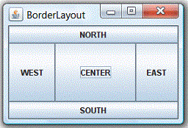
Border Layout
In BorderLayout, the container is divided into 5 zones: EAST, WEST, SOUTH, NORTH, and CENTER
A component at east or west extends vertically up to the bottom of the North component or to the top of the container (if there is no North component)
Similarly for south component

Slide 25
Border Layout
public BorderLayout();
public BorderLayout(int hgap, int vgap);
// By default: hgap=0, vgap=0

Slide 26
Example (Border Layout)
import java.awt.*;
import java.awt.event.*;
public class AWTBorderLayout extends Frame{
public AWTBorderLayout () {
setLayout(new BorderLayout(3, 3));
add(new Button("NORTH"),
BorderLayout.NORTH);
add(new Button("SOUTH"),
BorderLayout.SOUTH);
add(new Button("CENTER"),
BorderLayout.CENTER);
add(new Button("EAST"),
BorderLayout.EAST);
add(new Button("WEST"),
BorderLayout.WEST);
setTitle("BorderLayout");
setSize(280, 150);
setVisible(true);
}
public static void main(String[] args) {
new AWTBorderLayout();
}}

Slide 27
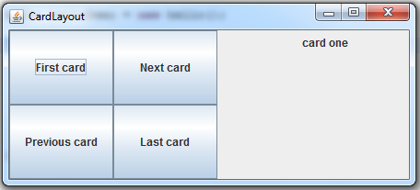
Card Layout
A CardLayout object is a layout manager for a container, such as a panel
Conceptually, each component that a CardLayout manages is like a playing card or trading card in a stack, where only the top card is visible at any time
The CardLayout class manages two or more components that share the same display space

Slide 28
Example (Card Layout)
import javax.swing.*;
import java.awt.*;
import java.awt.event.*;
public class CardDeck extends JFrame implements ActionListener {
private CardLayout cardManager;
private JPanel deck;
private JButton controls[];
private String names[] = { "First card", "Next card", "Previous card", "Last card" };
public CardDeck(){
super( "CardLayout " );
Container c = getContentPane();
deck = new JPanel();
cardManager = new CardLayout();
deck.setLayout( cardManager );
JLabel label1 = new JLabel( "card one", SwingConstants.CENTER );
JPanel card1 = new JPanel();
card1.add( label1 );
deck.add( card1, label1.getText() ); JLabel label2 = new JLabel( "card two", SwingConstants.CENTER );
JPanel card2 = new JPanel();
card2.setBackground( Color.yellow );
card2.add( label2 );
deck.add( card2, label2.getText() ); JLabel label3 = new JLabel( "card three" );
JPanel card3 = new JPanel();
card3.setLayout( new BorderLayout() );
card3.add( new JButton( "North" ), BorderLayout.NORTH );
card3.add( new JButton( "West" ), BorderLayout.WEST );
card3.add( new JButton( "East" ), BorderLayout.EAST );
card3.add( new JButton( "South" ), BorderLayout.SOUTH );
card3.add( label3, BorderLayout.CENTER );

Slide 29
Example (Card Layout)
deck.add( card3, label3.getText() );
JPanel buttons = new JPanel();
buttons.setLayout( new GridLayout( 2, 2 ) );
controls = new JButton[ names.length ];
for ( int i = 0; i < controls.length; i++ ) {
controls[ i ] = new JButton( names[ i ] );
controls[ i ].addActionListener( this );
buttons.add( controls[ i ] );
}
c.add( buttons, BorderLayout.WEST );
c.add( deck, BorderLayout.EAST );
setSize( 450, 200 );
show();
}
public void actionPerformed( ActionEvent e )
{
if ( e.getSource() == controls[ 0 ] )
cardManager.first( deck ); // show first card
else if ( e.getSource() == controls[ 1 ] )
cardManager.next( deck ); // show next card
else if ( e.getSource() == controls[ 2 ] )
cardManager.previous( deck ); // show previous card
else if ( e.getSource() == controls[ 3 ] )
cardManager.last( deck ); // show last card
}
public static void main( String args[] )
{
CardDeck cardDeckDemo = new CardDeck();
cardDeckDemo.addWindowListener(
new WindowAdapter() {
public void windowClosing( WindowEvent e )
{
System.exit( 0 );
} });
}}

Slide 30
Frame and JFrame
Frame is part of java.awt package and exists since JDK1.0
JFrame is part of javax.swing package and exists since JDK1.1.3 or something
Frame extends Window
JFrame extends Frame
We can directly add components to Frame
We add components to JFrame.getContentPane()

Slide 31
JPanel
JPanel is a public java swing class which is used to create a general-purpose container
JPanel panel objects can add color to their background and also can be customized
JPanel inherits methods from it’s super classes namely JComponent, Container, and Component java classes
JPanel is an extension of java swing JComponent class. JPanel

Slide 32
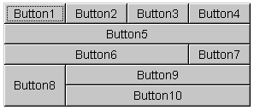
GridBag Layout
The GridBagLayout class is a flexible layout manager that aligns components vertically and horizontally, without requiring that the components be of the same size
Each GridBagLayout object maintains a dynamic, rectangular grid of cells, with each component occupying one or more cells
The position and behavior of each element is specified by an instance of the GridBagConstraints class

Slide 33
GridBag Layout
JPanel pane = new JPanel(new GridBagLayout()); GridBagConstraints c = new GridBagConstraints();
pane.add(theComponent, c);

Slide 34
Example (GridBag Layout)
import java.applet.*; import java.awt.*; public class MyGridBag extends Applet{ TextArea ObjTa; TextField ObjTf; Button butta, buttf; CheckboxGroup cbg; Checkbox cbbold, cbitalic, cbplain, cbboth; GridBagLayout gb; GridBagConstraints gbc; public void init(){ gb = new GridBagLayout(); setLayout(gb);
gbc = new GridBagConstraints(); ObjTa = new TextArea("TextArea ", 5, 10); ObjTf = new TextField("enter your Name"); butta = new Button("TextArea"); buttf = new Button("TextField");
cbg = new CheckboxGroup();
cbbold = new Checkbox("Bold", cbg, false); cbitalic = new Checkbox("Italic", cbg, false);
cbplain = new Checkbox("Plain", cbg, false); cbboth = new Checkbox("Bold/Italic", cbg, true);
gbc.fill = GridBagConstraints.BOTH;
addComponent(ObjTa, 0,0,4,1); gbc.fill = GridBagConstraints.HORIZONTAL; addComponent(butta, 0,1,1,1); gbc.fill = GridBagConstraints.HORIZONTAL; addComponent(buttf, 0,2,1,1); gbc.fill = GridBagConstraints.HORIZONTAL; addComponent(cbbold, 2,1,1,1); gbc.fill = GridBagConstraints.HORIZONTAL; addComponent(cbitalic, 2,2,1,1); gbc.fill = GridBagConstraints.HORIZONTAL; addComponent(cbplain, 3,1,1,1); gbc.fill = GridBagConstraints.HORIZONTAL;
addComponent(cbboth, 3,2,1,1); gbc.fill = GridBagConstraints.HORIZONTAL; addComponent(ObjTf, 4,0,1,3); } public void addComponent(Component comp, int row, int col, int nrow, int ncol){ gbc.gridx = col; gbc.gridy = row; gbc.gridwidth = ncol; gbc.gridheight = nrow; gb.setConstraints(comp,gbc); add(comp); }
}

Slide 35
Outlines of Presentation
Creating Graphical User Interfaces with AWT
Managing Graphics Objects with GUI Layout Managers
Event Handling of Various Components

Slide 36
Events and Listeners
In event-driven programming, code is executed upon activation of events
An event can be defined as a type of signal to the program that something has happened
The event is generated by external user actions such as:
Moving the mouse
Clicking the button
Pressing a key
Sliding the scrollbar thumb
Choosing an item from a menu
Events are responded to by event listeners

Slide 37
Event Handling Model
To process an event
Register an event listener
Implement event handler
Method that is called in response to an event
Each event handling interface has one or more event handling methods that must be defined

Slide 38
The Event Handling process
When an event is triggered, the JAVA runtime first determines its source and type
If a listener for this type of event is registered with the source, an event object is created
For each listener to this type of an event
The JAVA runtime invokes the appropriate event handling method to the listener and passes the event object as the parameter

Slide 39
Selected User Actions
User Action
Click a button
Select a new item
Select an item from a List
Window opened, closed
Mouse pressed, released
Key released, pressed
Source Object
Jbutton
JComboBox
Jlist
Window
MouseEvent
KeyEvent
Event Type Generated
ActionEvent
ItemEvent, ActionEvent
ListSelectionEvent
WindowEvent
MouseEvent
KeyEvent

Slide 40
Java AWT Event Listener Interfaces
ActionListener
ItemListener
KeyListener
MouseListener
WindowListener
ListSelectionListener

Slide 41
EventListner and ActionListener
An Event Listener, once set to an applet object waits for some action to be performed on it
It mouse click, mouse hover, pressing of keys, click of button, etc
ActionListener is an interface that could be implemented in order to determine how certain event should be handled
When implementing an interface, all methods in that interface should be implemented, ActionListener interface has one method to implement named actionPerformed()

Slide 42
Selected Event Handlers
Event Class Listener Interface Listener Methods (Handlers)
ActionEvent ActionListener actionPerformed(ActionEvent)
ItemEvent ItemListener itemStateChanged(ItemEvent)
ListSelection ListSelection valueChanged (ListSelectionEvent)
Event Listener

Slide 43
How to Implement a Listener Interface
Use the implements keyword in the class declaration
Register the object as a listener for a component’s event, using the component’s addXListener method. (where X is the type of event).
Declare and fully define all methods for the interface that you are implementing

Slide 44
Example
import java.awt.* ;
import java.awt.event.* ;
public class hello
{
public static void main(String args[ ] )
{
Frame f = new Frame ("My Frame");
MyGuiAction ga = new MyGuiAction(f);
}
}
class MyGuiAction implements ActionListener
{
static int count = 0;
Button b;
TextField tf;
MyGuiAction(Frame f)
{
b = new Button("OK");
b.addActionListener(this);
tf = new TextField("Hello Java", 20);
f.setLayout(new FlowLayout());
f.add(b);
f.add(tf);
f.setSize(300, 300);
f.setVisible(true);
}
public void actionPerformed( ActionEvent e)
{
if(e.getSource() == b)
{
count++ ;
System.out.println("Button is Pressed");
tf.setText("Hello Java Click "+ count);
}
}
}

Slide 45
Three Steps of Event Handling
Prepare to accept events
import package java.awt.event
Start listening for events
include appropriate methods
Respond to events
implement appropriate abstract method

Slide 46
Prepare to accept events
Import package java.awt.event
Applet manifests its desire to accept events by promising to “implement” certain methods
Example:
“ActionListener” for Button events
“AdjustmentListener” for Scrollbar events

Slide 47
Start listening for events
To make the applet “listen” to a particular event, include the appropriate “addxxxListener”.
Examples: addActionListener(this)
shows that the applet is interested in listening to events generated by the pushing of a certain button
addAdjustmentListener(this)
shows that the applet is interested in listening to events generated by the sliding of a certain scroll bar thumb

Slide 48
Respond to events
The appropriate abstract methods are implemented.
Example:
actionPerformed() is automatically called whenever the user clicks the button
Thus, implement actionPerformed() to respond to the button event
adjustmentValueChanged() is automatically invoked whenever the user slides the scroll bar thumb
So adjustmentValueChanged() needs to be implemented
In actionPerformed(ActionEvent evt), ActionEvent is a class in java.awt.event

Slide 49
ActionEvent
In Java, most components have a special event called an ActionEvent
This is loosely speaking the most common or canonical event for that component
A good example is a click for a button
To have any component listen for ActionEvents, you must register the component with an ActionListener
e.g. button.addActionListener(new MyAL());

Slide 50
ActionPerformed
The actionPerformed method has the following signature:
void actionPerformed(ActionEvent)
The object of type ActionEvent passed to the event handler is used to query information about the event
Some common methods are:
getSource()
object reference to component generating event
getActionCommand()
some text associated with event (text on button, etc)

Slide 51
Event Handler Code
class MyActionListener implements ActionListener{
public void actionPerformed(ActionEvent ae){
JOptionPane.showMessageDialog(“I got clicked”, null);
}
}

Slide 52
import java.awt.*;
import java.applet.*;
import java.awt.event.*;
import java.awt.Label;
public class Sample extends Applet implements ActionListener{
TextField text1,text2,output;
Label label1,label2,label3,title;
Button button,clear;
public void init(){
setLayout(null);
title = new Label("Addition of Two Numbers");
title.setBounds(80,10,140,20);
add(title);
title.setAlignment(title.CENTER);
label1 = new Label("Enter Number 1: ");
label1.setBounds(20,50,100,20);
add(label1);
text1 = new TextField(5);
text1.setBounds(150,50,100,20);
add(text1);
label2 = new Label("Enter Number 2: ");
label2.setBounds(20,90,100,20);
add(label2);

Slide 53
text2 = new TextField(5);
text2.setBounds(150,90,100,20);
add(text2);
label3 = new Label("Sum of Two Numbers: ");
label3.setBounds(20,130,130,20);
add(label3);
output = new TextField(5);
output.setBounds(150,130,100,20);
add(output);
button = new Button("Sum");
button.setBounds(150,170,100,20);
add(button);
clear = new Button("Clear");
clear.setBounds(280,170,100,20);
add(clear);
button.addActionListener(this);
clear.addActionListener(this);
}
public void actionPerformed(ActionEvent ae){
int num1=Integer.parseInt(text1.getText());
int num2=Integer.parseInt(text2.getText());
int sum=num1+num2;
output.setText(Integer.toString(sum));
}

